Slide 1
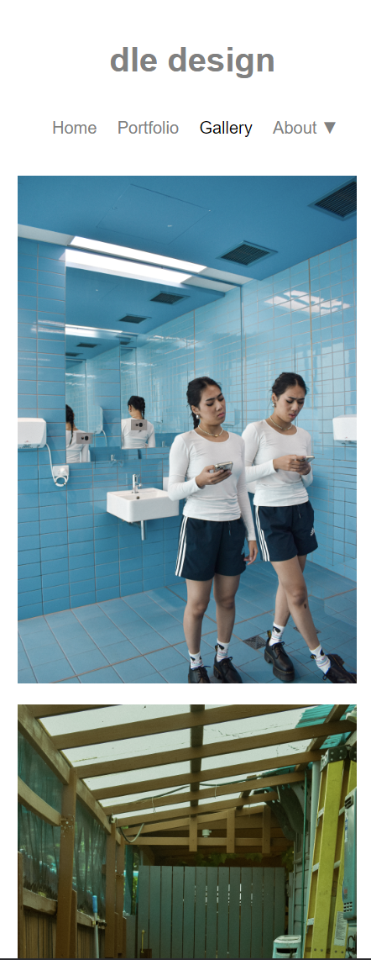
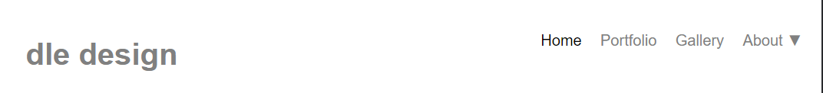
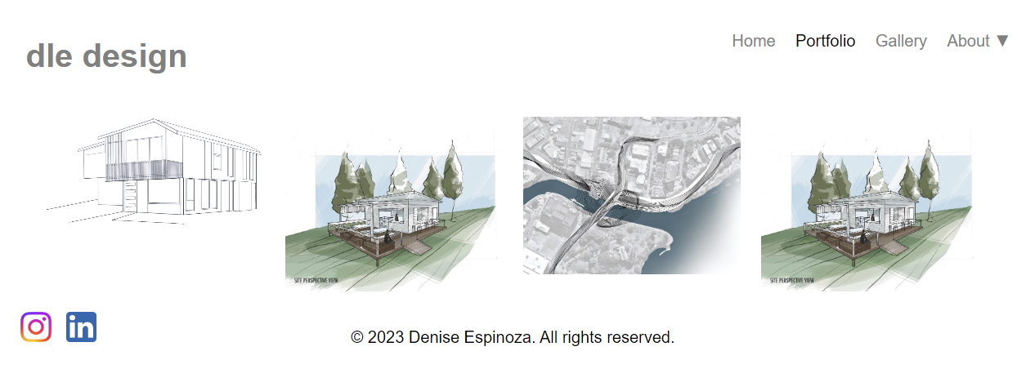


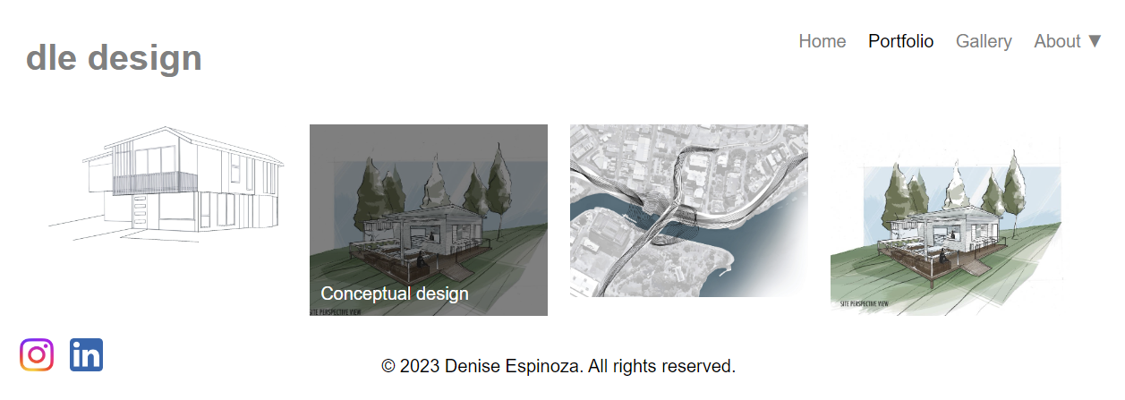
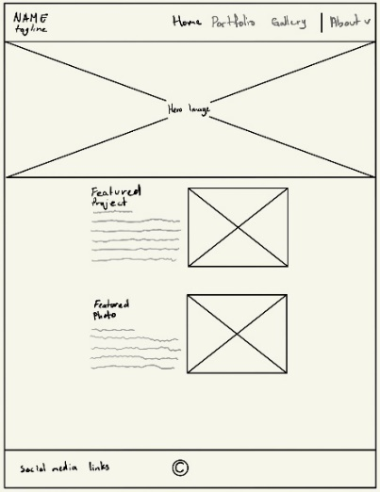
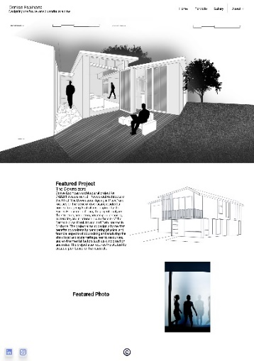
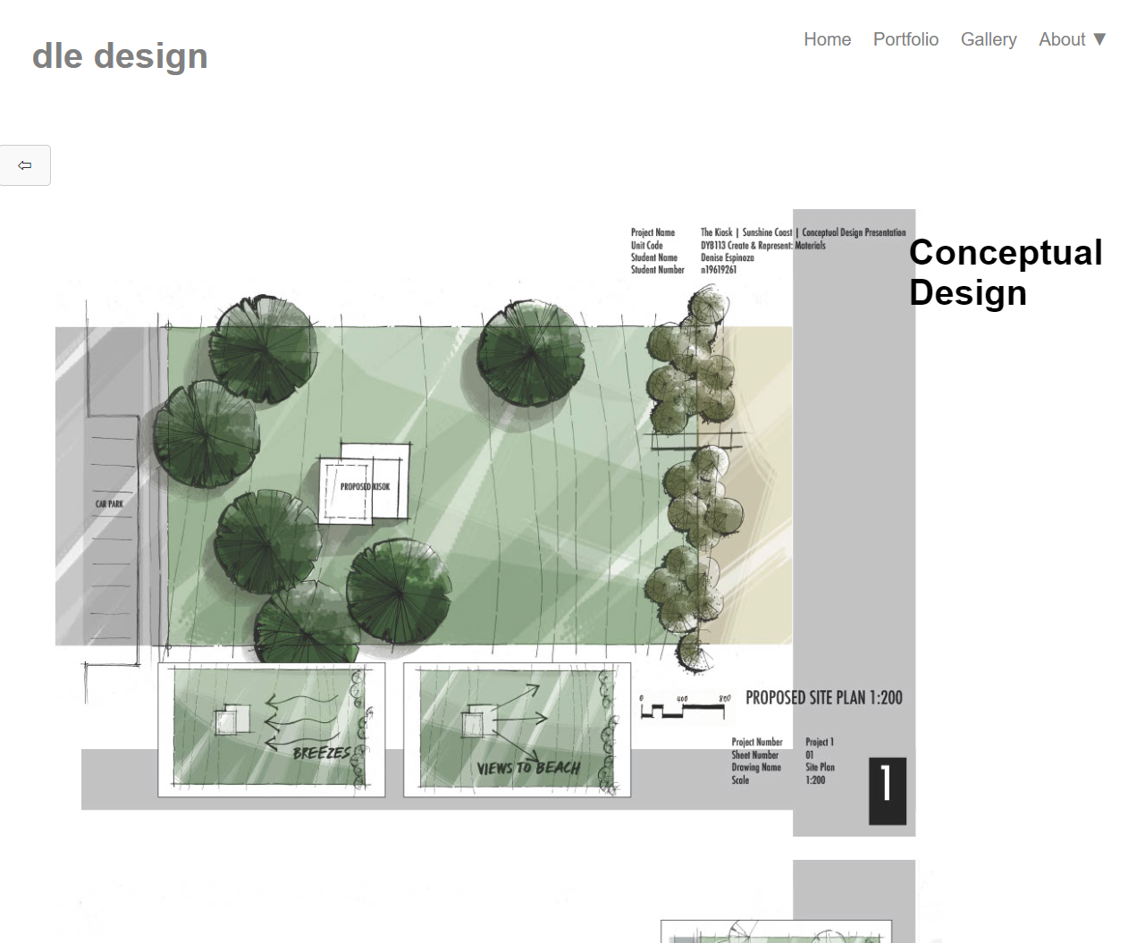
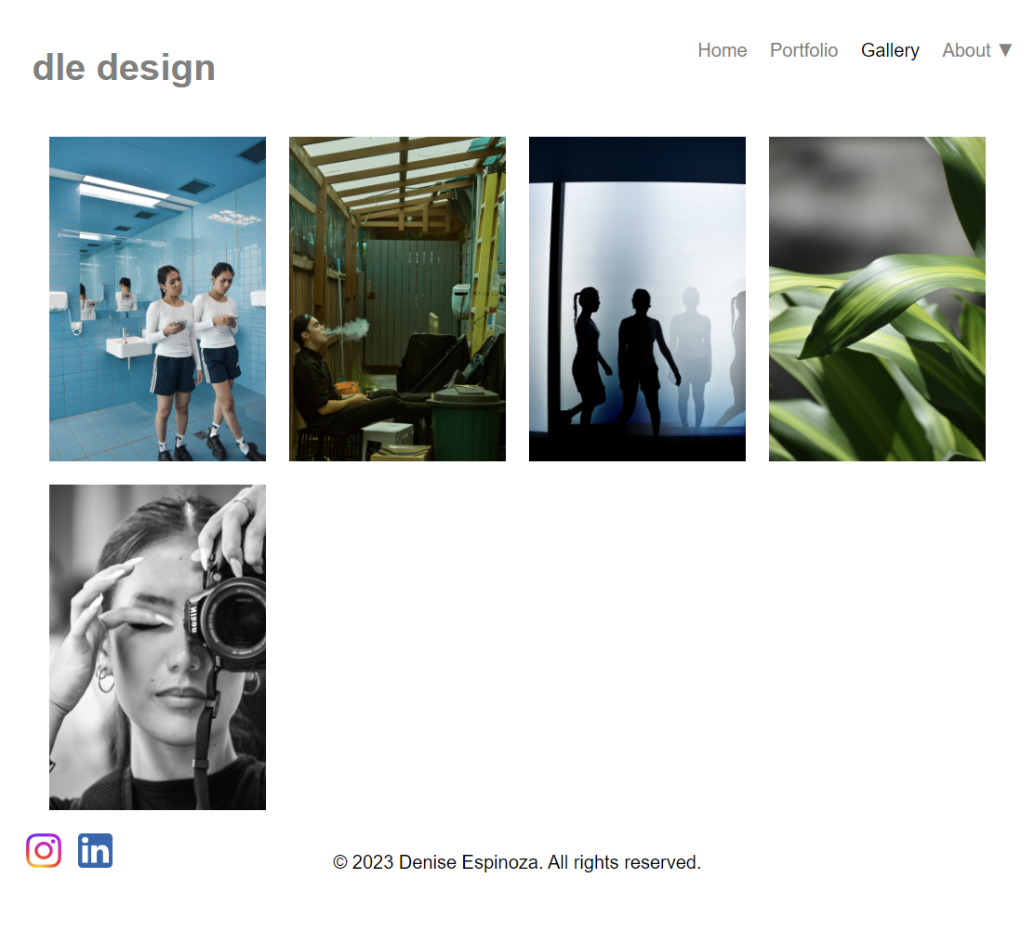
Student Portfolio Website Implementation
Erik Flink
Introduction
This guide poster will take you on a journey exploring the creation of my personal website, which displays my student portfolio. It showcases my utilization of design principles, user experience enhancements, and web development techniques.
Potential Audience
The website aims to reach a diverse audience including prospective clients, employers, and colleagues within the architectural industry. Its purpose is to exhibit the student's architectural endeavors and establish their personal identity as a driven and aspiring architect. In the ever-evolving digital landscape, this portfolio website serves as a potent instrument for the student to stand out, showcasing their unique design sensibilities and setting themselves apart from the competition.
Design Prototypes
The website's design process began with the creation of low-fidelity prototypes, using hand-drawn sketches for rapid visualization of the site's layout and essential features. Building upon this, high-fidelity prototypes were developed using Figma, resulting in a precise, visually appealing, and user-friendly website design.
Key Features Enhancing UI and UX
Consistent Navigation: Persistent navbar and footer aids in seamless navigation.
Hover Effects: Gives immediate feedback to user actions, enhancing interactivity.
Clear Labels and Headings: Enhances clarity and ease of use.
Error Prevention: Form validation on contact page reduces user errors.
Aesthetically Pleasing Design: Minimalist and visually appealing design improves overall user satisfaction.
Final Website
The completed version of the website stands as a clear reflection of the student's individual design style and expertise. It showcases various features that contribute to its overall appeal, such as an intuitive navigation system, a comprehensive project display on the portfolio page, visually captivating image selection in the gallery, and an efficient communication process through the contact page.
During the development process, I took great care to create a website layout that dynamically adapts to different screen sizes, ensuring an optimal viewing experience while maintaining aesthetic appeal. This adaptive design feature was born out of the realization that mobile browsing is becoming increasingly prevalent. It highlights the importance of delivering a seamless multi-device experience to effectively cater to our diverse audience's browsing preferences.
Gallery
Narrow Screen
To enhance interactivity, project thumbnails and navigational elements incorporate hover animations. These animations provide users with detailed information about the respective link, elevating the user experience without requiring them to access the full page.
Reflection
Overcoming front-end obstacles played a crucial role in the website's creation. We prioritized responsiveness through the implementation of CSS media queries. Optimizing performance involved resizing image files. Despite initial confusion with the CSS layout, code organization was upheld by incorporating comments and separating code into individual files. Moreover, exploring the use of JavaScript event listeners to enhance interactivity introduced a fresh concept distinct from the traditional coding languages I had experience with. This innovation significantly elevated the user interface and overall experience.
Future Work:
With additional time at hand, there exist numerous possibilities for enhancing the website. These encompass the incorporation of a commenting feature to foster heightened user engagement, the introduction of a dedicated blog section for sharing valuable industry insights, and the enhancement of SEO practices to expand the website's reach to a broader audience.
Portfolio
The student architect aimed to place their projects at the forefront, leading to the creation of a minimalistic website featuring impactful images. This concept is brought to life on the Project page, where the project title remains fixed as users scroll through the visuals, enabling the work to communicate its message without distractions.
Low Fidelity
High Fidelity
Gallery
Wide Screen
Project Page

